Slide 1
Invest Health Syracuse Pod Convening
September 18-19, 2017

Slide 2
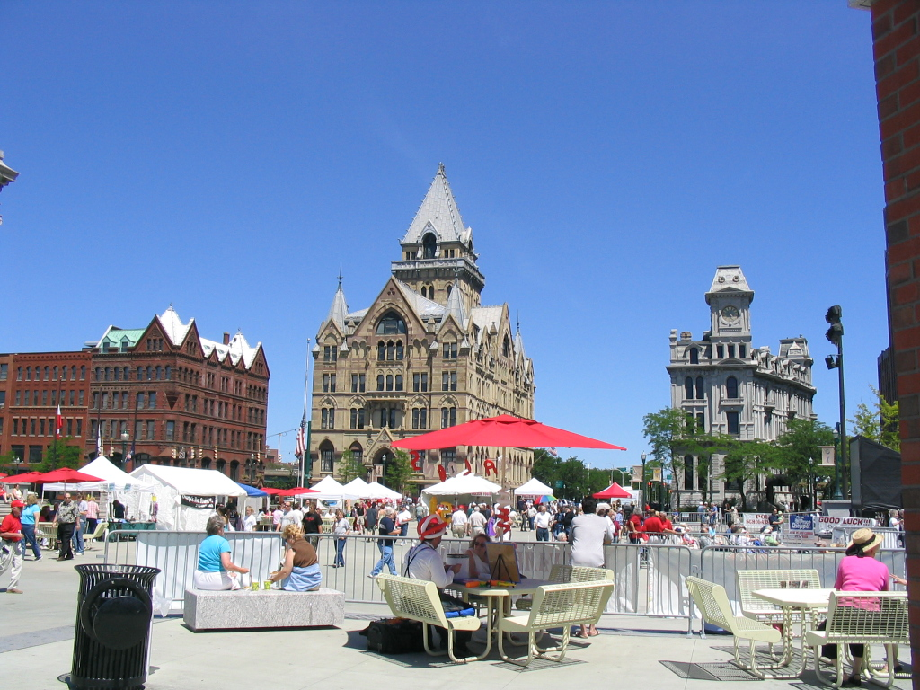
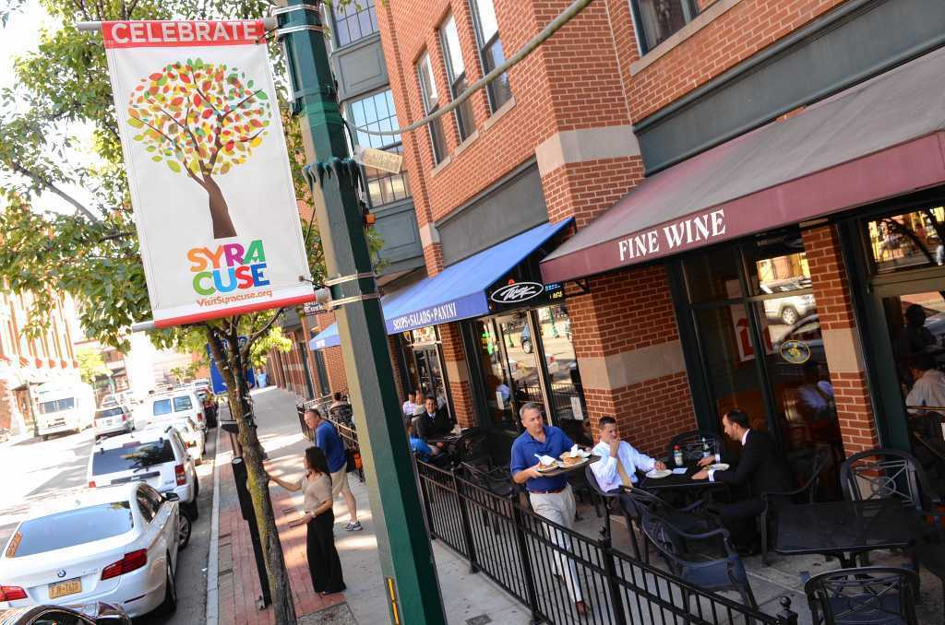
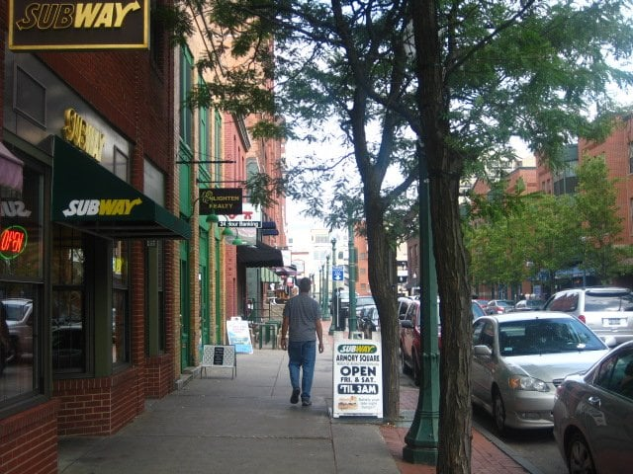
Investing in Health (Outcomes) in Downtown Syracuse, NY
September 18, 2017

Slide 3
Who We Are: Invest Health Team Syracuse
Heather Schroeder Economic Development Program Manager, Downtown Committee of Syracuse, Inc.
Rebecca Shultz Director, Bureau of Surveillance & Statistics, Onondaga County Health Department
Dan Cowen
Deputy Director, Economic Inclusion
CenterState CEO
Meagan Weatherby Development and Communications Manager, Cooperative Federal
Paul Driscoll Commissioner of Neighborhood and Business Development, City of Syracuse
Simone Seward Director, Center for Civic Engagement, Upstate Medical University

Slide 4
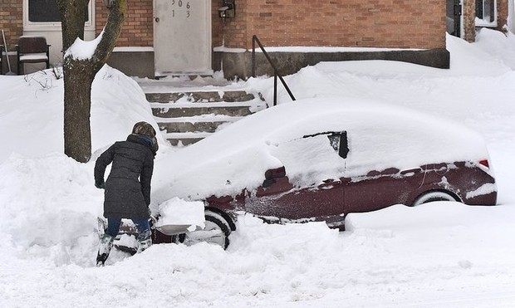
You Are Here

Slide 5
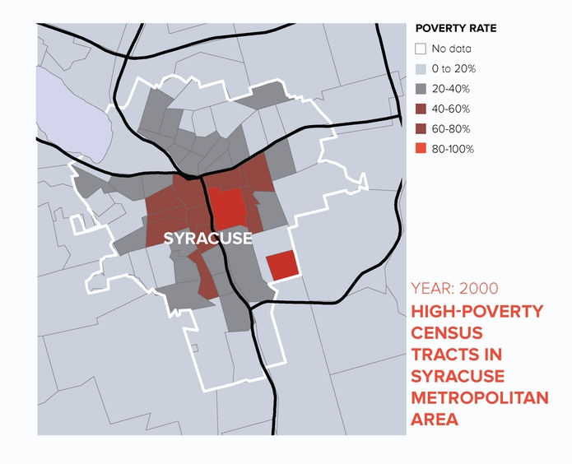
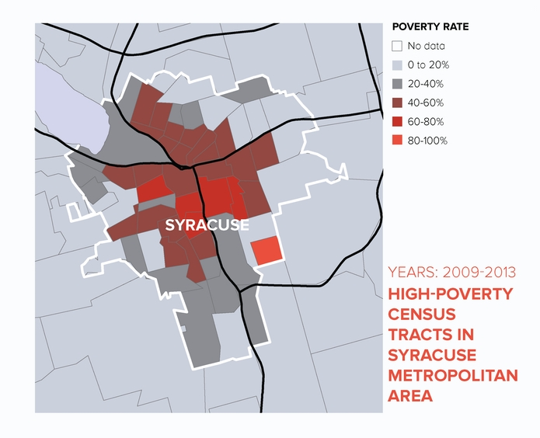
Concentrated Poverty in Syracuse
Paul A. Jargowsky, Architecture of Segregation: Civil Unrest, the Concentration of Poverty, and Public Policy, a Report of The Century Foundation (New York, NY: Century Foundation, 2015). https://tcf.org/content/report/architecture-of-segregation/

Slide 6
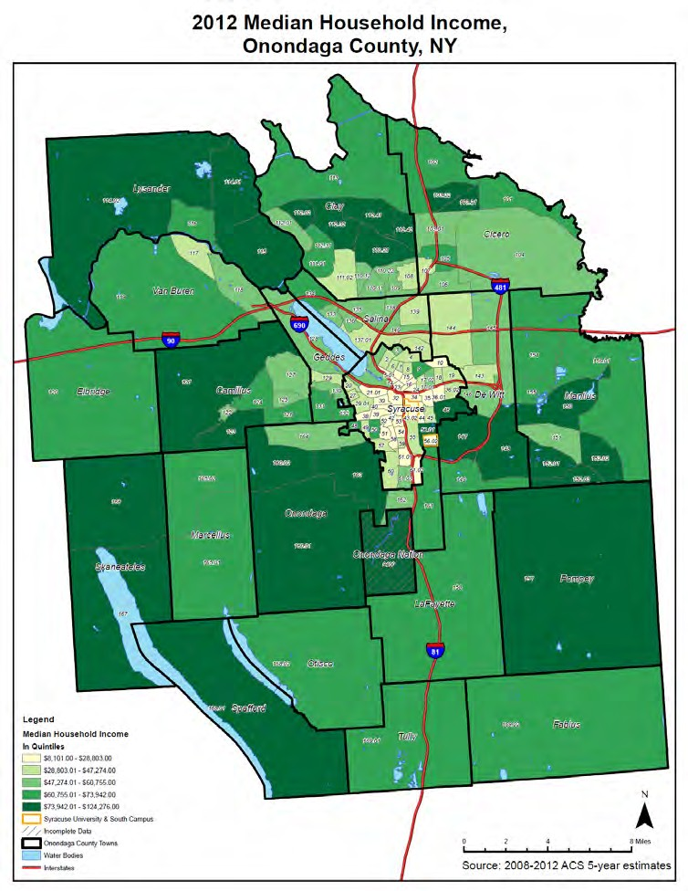
Analysis of Impediments to Fair Housing: Syracuse and Onondaga County, 2014. CNY Fair Housing. http://cnyfairhousing.org/wp-content/uploads/2014/11/CNY-Fair-Housing-sm2.pdf

Slide 7
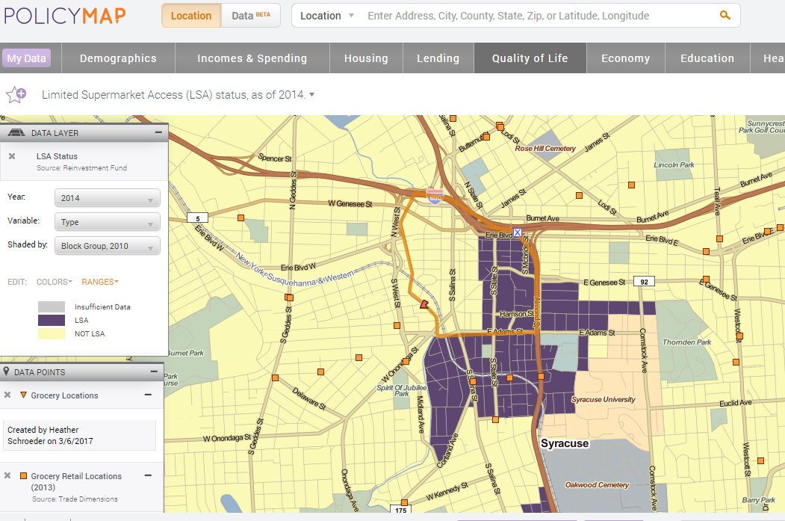

Slide 8
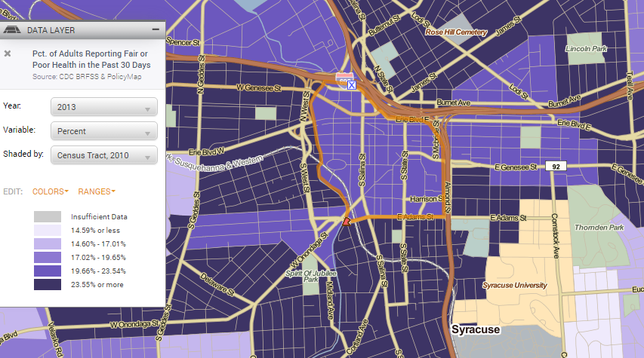
Health Perceived as Fair or Poor

Slide 9
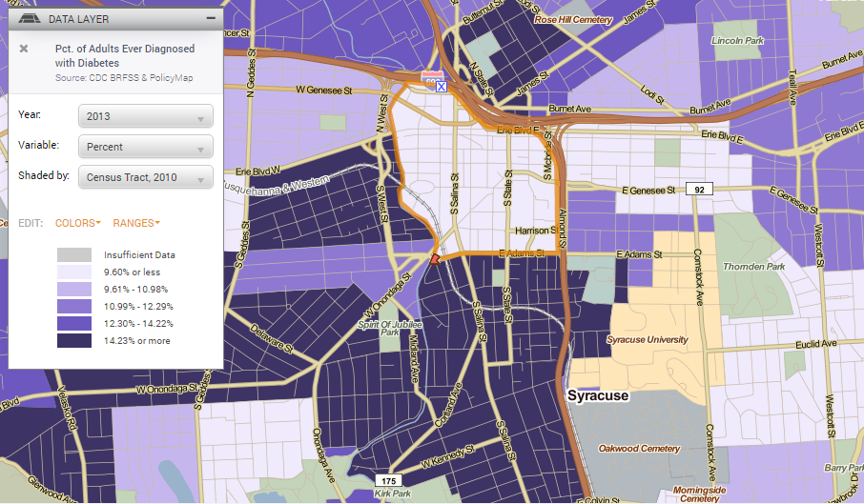
Diabetes

Slide 10
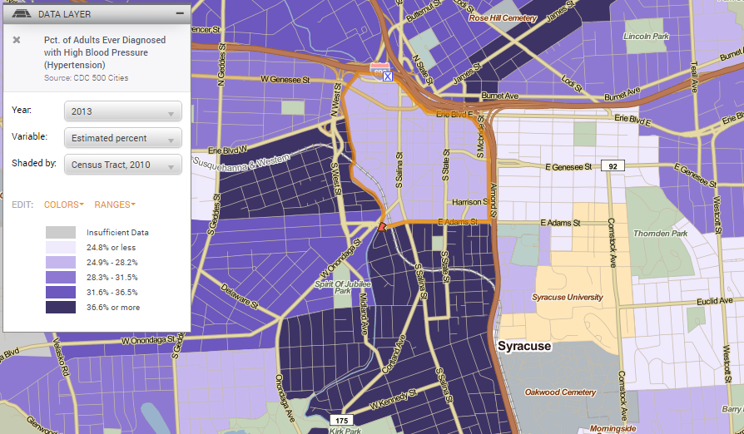
High Blood Pressure

Slide 11
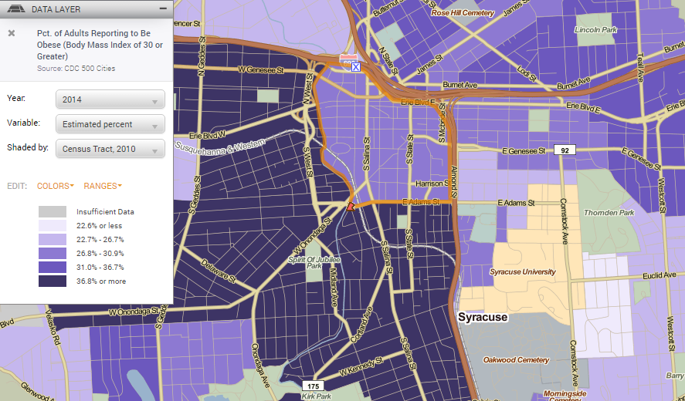
Obesity

Slide 12
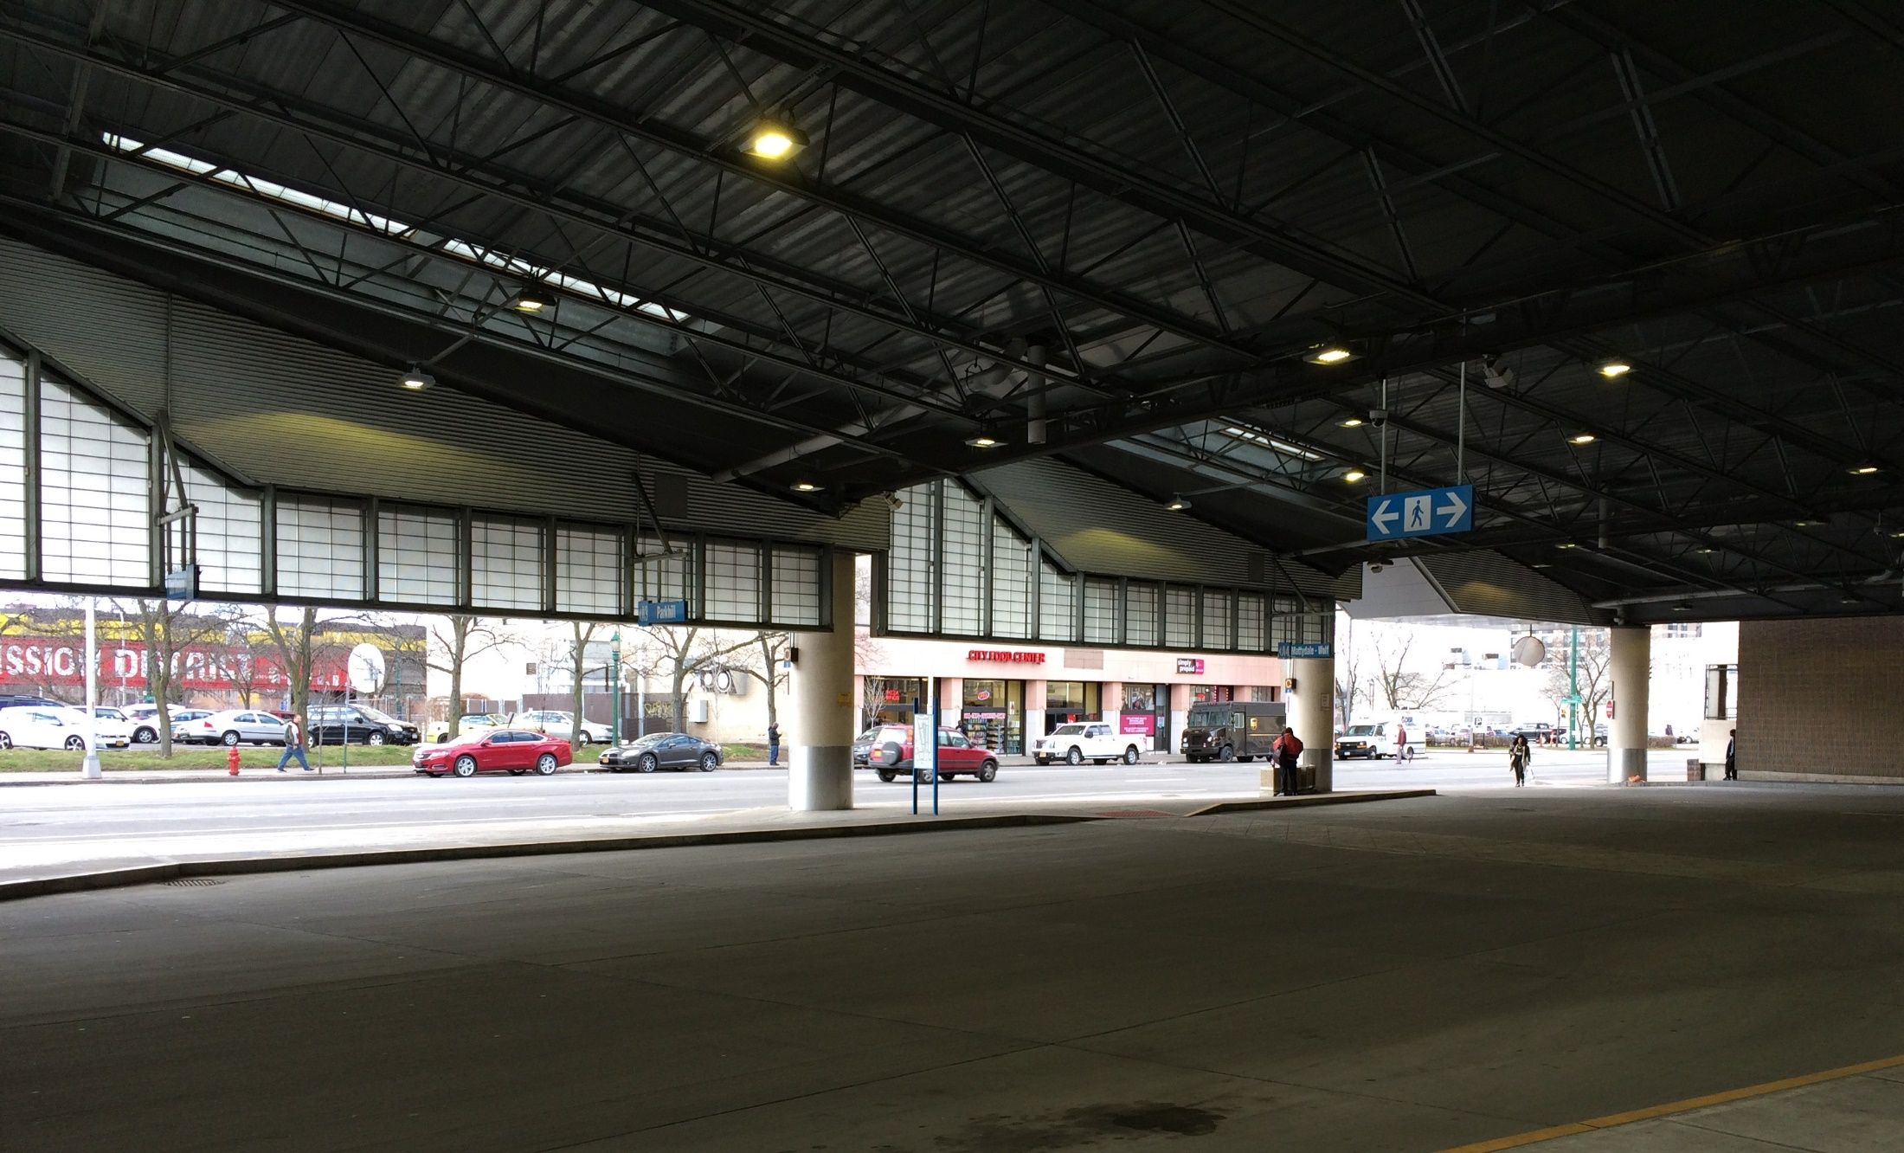
Transit-Oriented Development - Opportunity

Slide 13
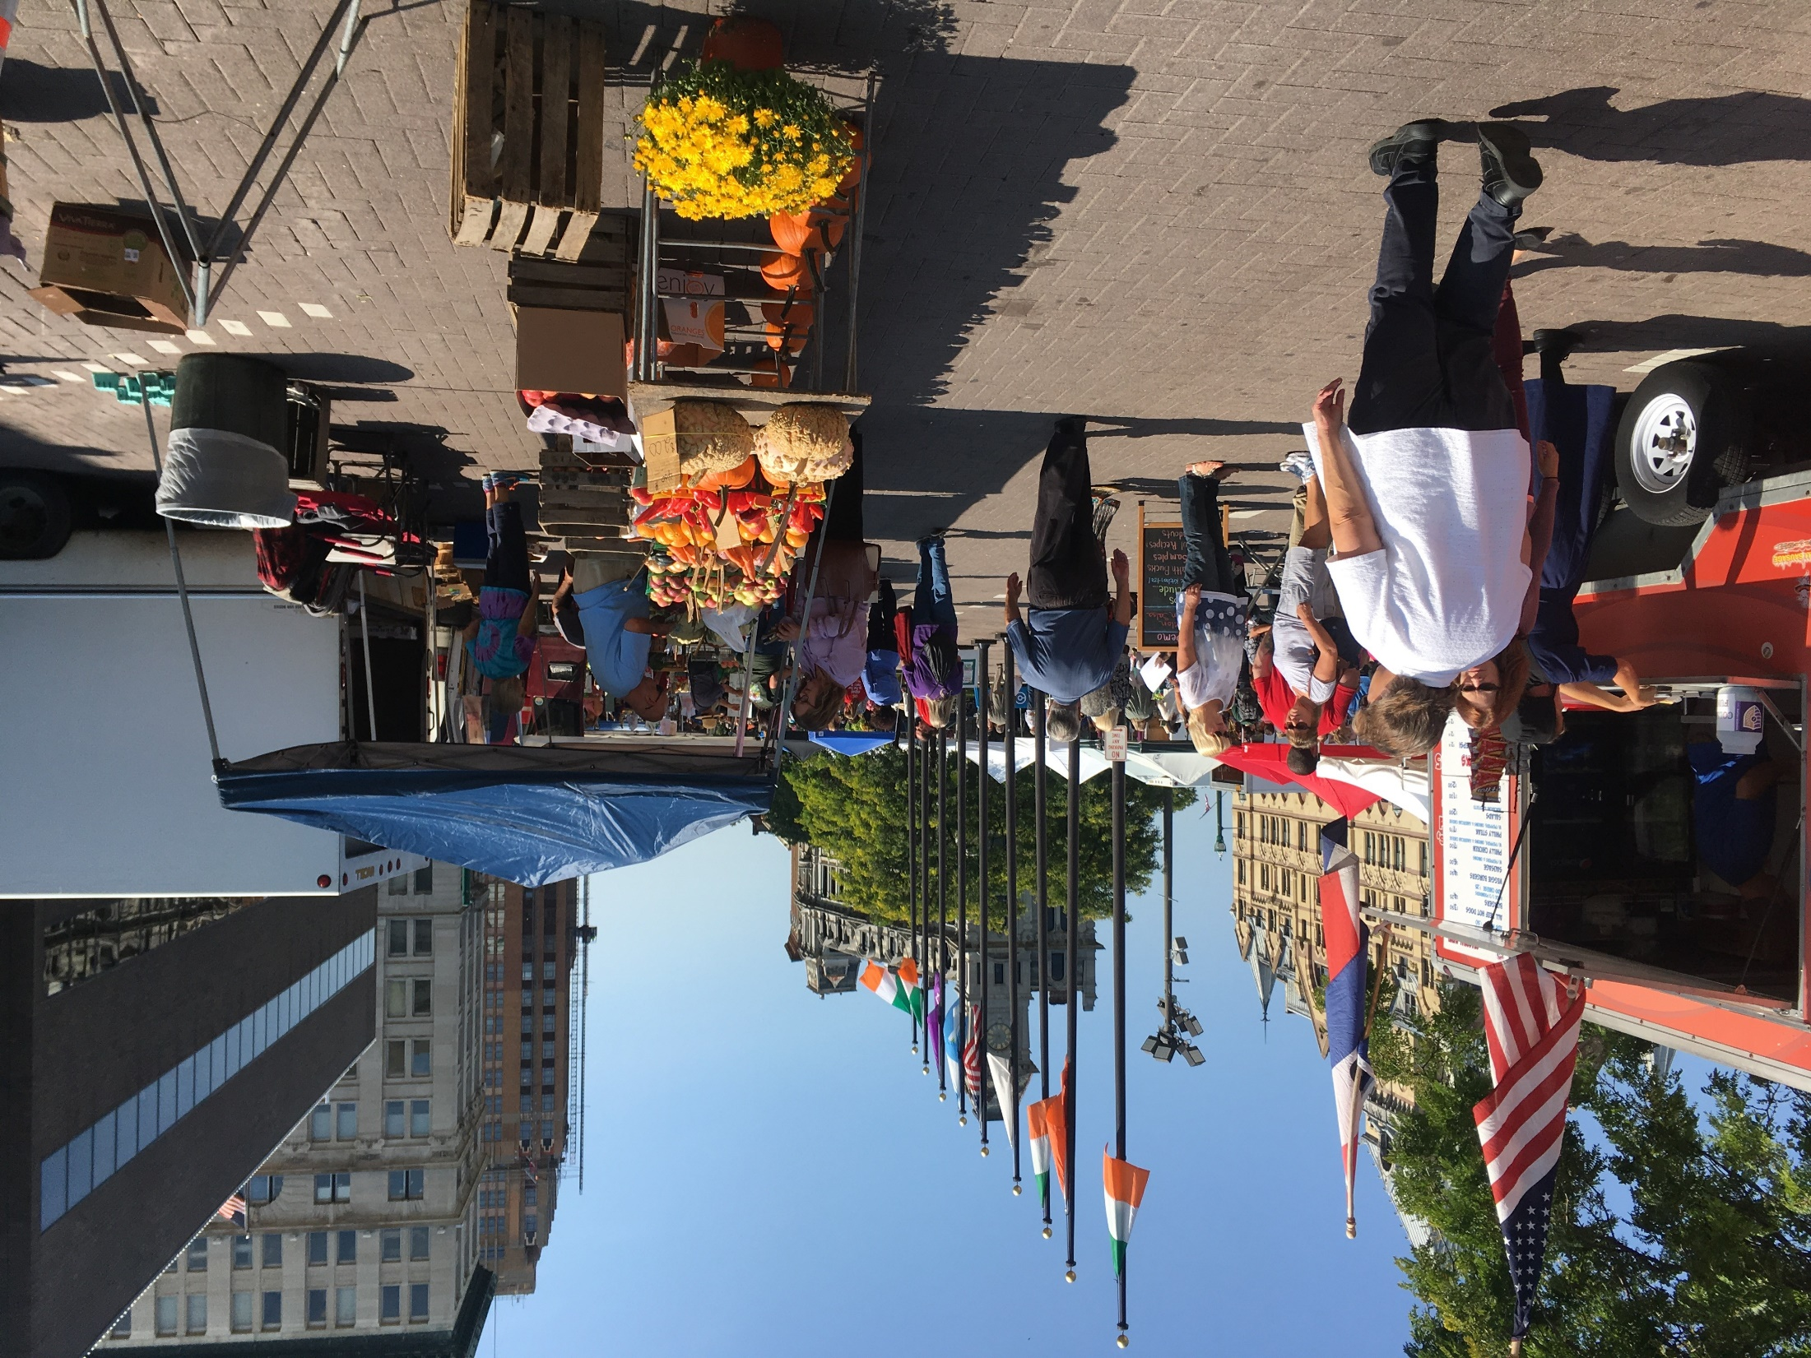

Slide 14
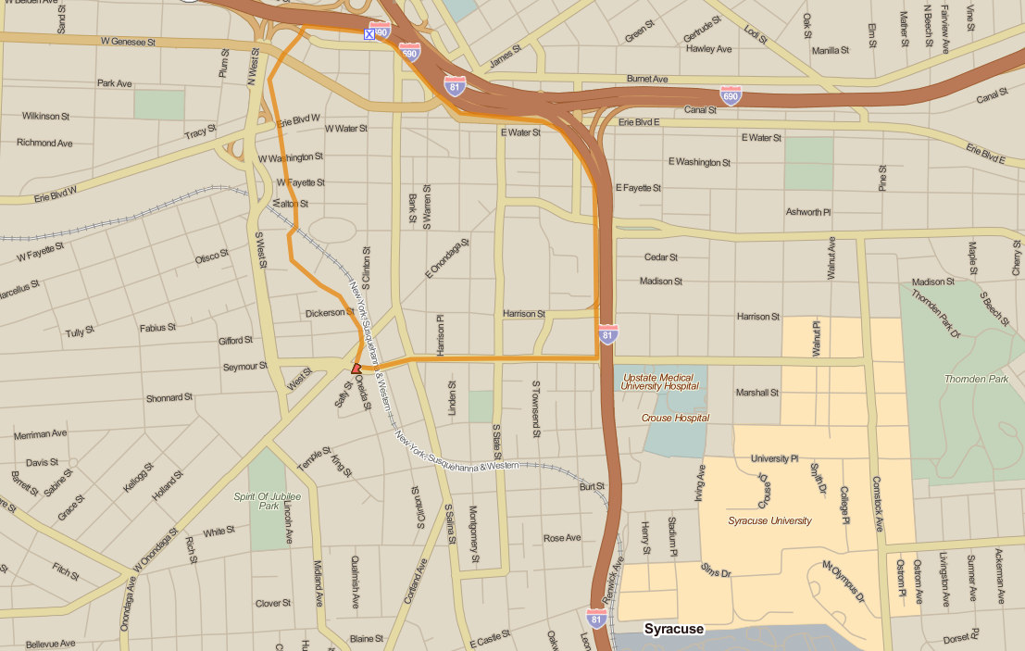
ConventionDistrict
The Hill
Syracuse Housing Authority

Slide 15
Consumer Survey Results – Grocery Shopping
 | Market rate | Low income
Top 3 shopping locations | Large chain grocers Farmer’s Market Drug stores | Superstores Locally-owned grocers Drug stores
Mode of transportation | Driving self | Walking, bus or ride with another
Most popular items | Fresh fruits and vegetables Dairy Leafy greens | Bread, bagels or bakery Dairy Poultry
Payment method | Debit or credit card | SNAP
Priorities when shopping | Quality of food Selection Store cleanliness | Quality of food Price Selection

Slide 16
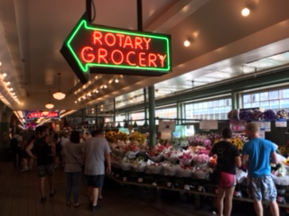
The Food Hall Model

Slide 17
Vision
To connect capital investors and stakeholders from various sectors to strategically located, vacant Downtown properties which can be repurposed into mixed-used facilities offering healthy food options, mixed-income housing, small business opportunities, and economic growth to reduce risk factors that lead to chronic diseases and to promote a better quality of life.

Slide 18
