Slide 1
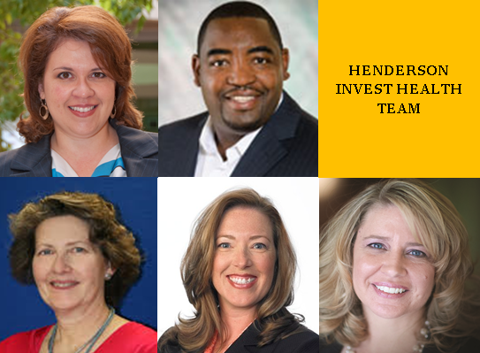
HENDERSON, NV

Slide 2
Investing in Health Holly Lyman, MPH, Director Community Health Henderson Invest Health Team Member

Slide 3
Clark County Service Area - 7 hospitals
Hospitals
in Henderson

Slide 4
Dignity Health – St. Rose Dominican
Only not-for-profit, religiously sponsored hospitals in Nevada
Adrian Dominican Sisters started the mission in Henderson 75 years ago
Provided $164,858,195 in Community Benefit FY16
Community Investments & Dignity Health Grants

Slide 5
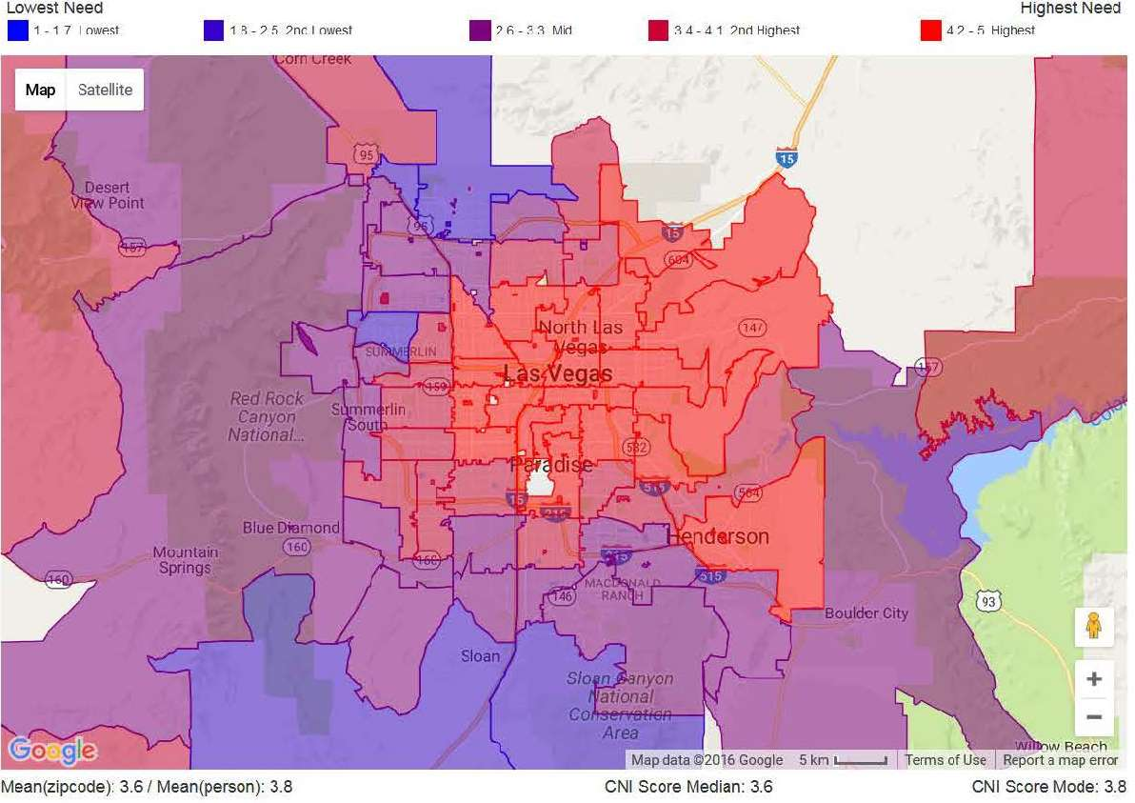
Community Health Needs Assessment
Focus Area
Chronic Disease
Access to Care

Slide 6
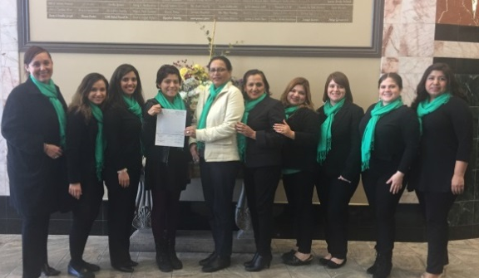
Dignity Health Grants 2017
St. Rose funded $319,634 in community grants to local non-profit partners
Catholic Charities & Volunteers in Medicine: $100,000 Medical Care for Homeless
Boulder City Lend a Hand $20,000: Transportation for homebound seniors
Las Vegas CHIPS $100,000: Healthcare and navigation services for 911 callers
UNLV Ollie $45,000 : Expand evidence based programs to more seniors
Vision y Compromiso $54,634: Implement Promotoras program in Nevada

Slide 8
Evidence-Based Programs
Stanford CDSME
Helping Hands Senior Transportation Program
12 Community Health Workers & 40 Promotoras
WIC & SNAP Enrollment
Nevada Health Link & Medicaid Enrollment
Diabetes Lifestyle Center
Congestive Heart Active Management (CHAMP)
Senior Peer Counseling
Caregivers, Fall Prevention & Kidney Smart

Slide 9
Unleash the healing power
of Humanity
Creative Single Image Portfolio Options

Slide 10
Questions?
Holly Lyman, MPH Director Community Health
Dignity Health Holly.Lyman@DignityHealth.org
Thank you!!

Slide 11
PROMOTING HEALTHY PEOPLE IN HEALTHY SOUTHERN NEVADA
Deborah Williams, MPA, MPH, CHES
Manager, Office of Chronic Disease Prevention & Health Promotion Henderson Invest Health Team Member

Slide 12
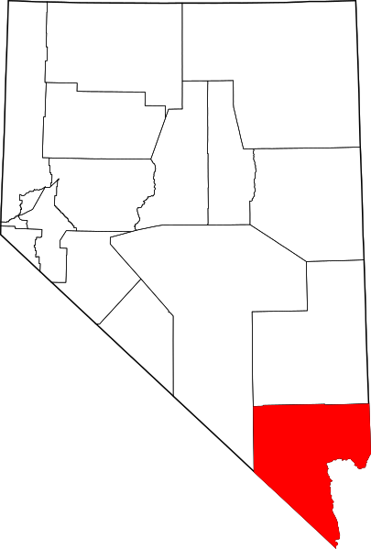
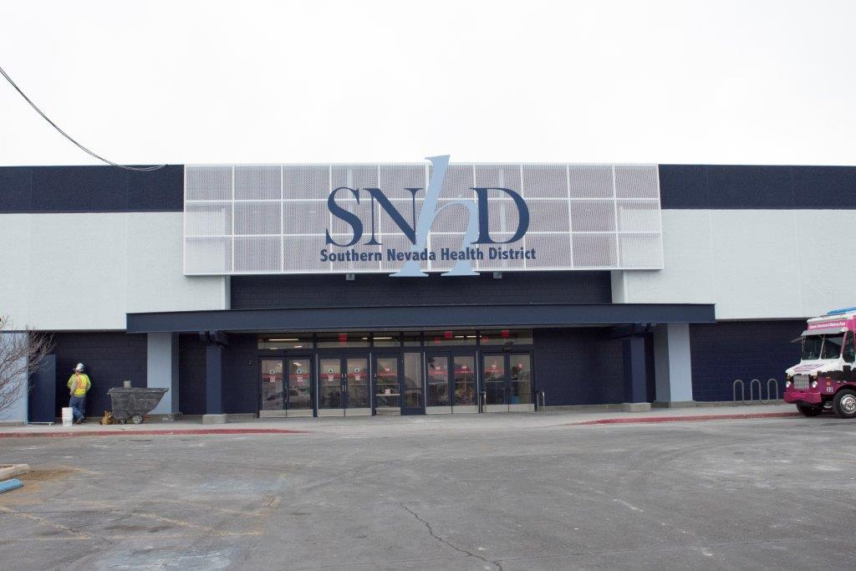
Southern Nevada Health District (SNHD)
Local public health authority serving Clark County, NV
approx. 2.1 million residents and 40 million annual visitors
Vision
Healthy people in a healthy southern Nevada
Nevada

Slide 13
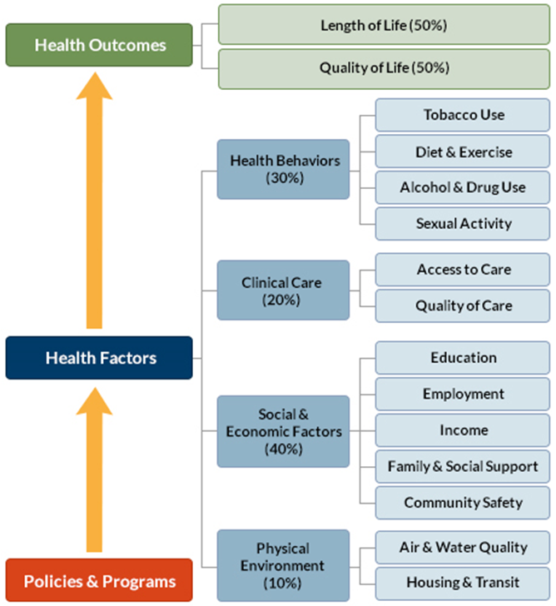
County Health Rankings

Slide 14
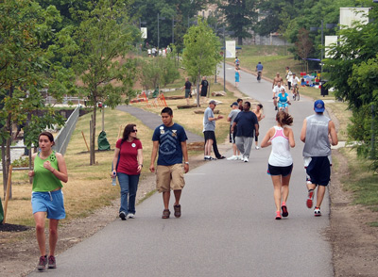
What SNHD brings to Invest Health
Evidence-based public health best practices
Public health system partnerships
Data (www.healthysouthernnevada.org website)

Slide 15
How SNHD benefits from Invest Health
New or strengthened partnerships
Other sectors embracing public health goals to improve health outcomes
New information

Slide 16
Questions?
Deborah Williams, MPA, MPH, CHES
Manager, Office of Chronic Disease Prevention & Health Promotion Southern Nevada Health District williamsd@SNHD.ORG

Slide 17
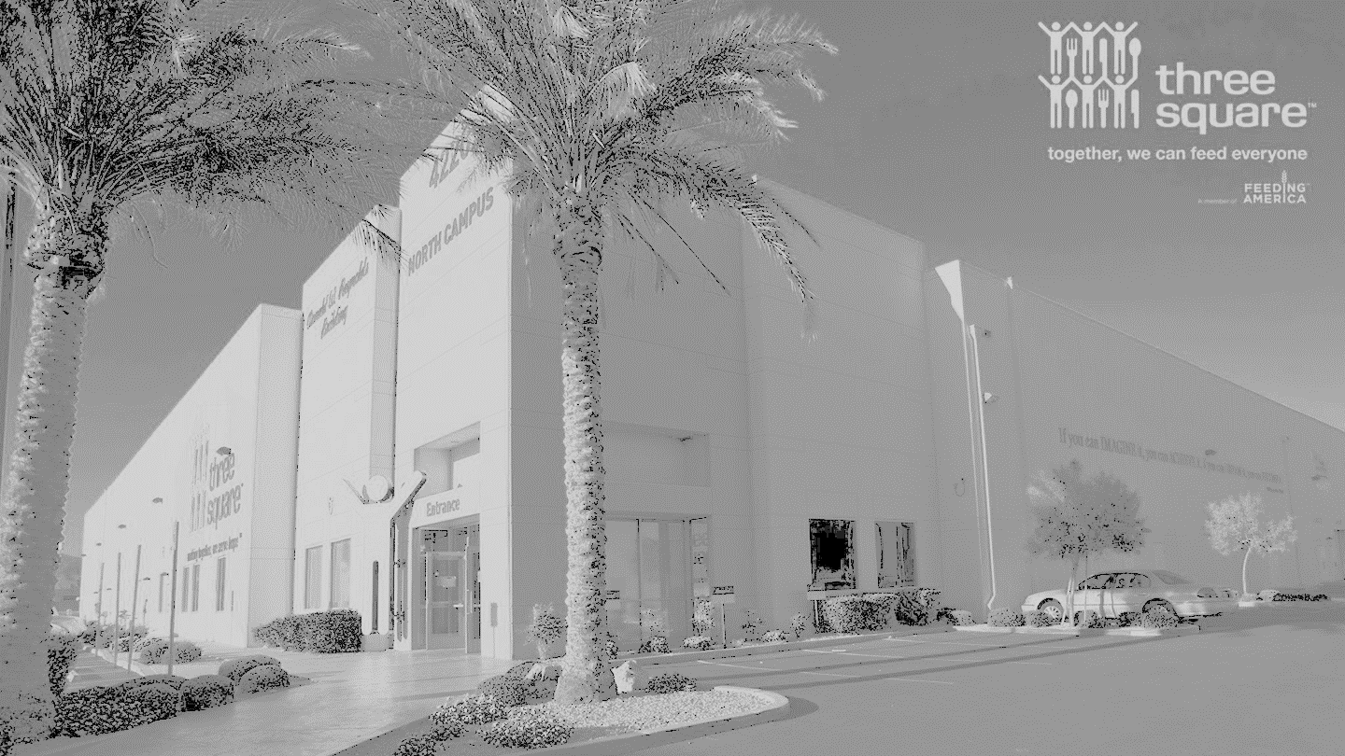
Three Square Food Bank and the Nexus of Health in Southern Nevada
Jodi Tyson, MPH
Government Affairs Director
Invest Health Team Member

Slide 18
Three Square’s Mission
Meeting the needs of people today:
Mitigate hunger by providing food through a large network of agency partners
Upstream approaches preventing hunger in the future:
Tackling the root causes of food insecurity
Employment/income
Education
Affordable housing
Healthcare
Quality of life: physical, mental, social and cultural connections

Slide 19
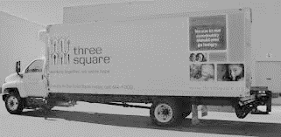
Three Square Programs and Services
Food Bank Warehouse and Distribution
Grocery/Product Rescue
Community Kitchen
Means-Tested Benefits: SNAP, EAP, Medicaid, Health Insurance Subsidies, Cell Phones, Referrals to other agencies
Advocacy
Meal Programs
Pantry Distribution
Food Rescue

Slide 20
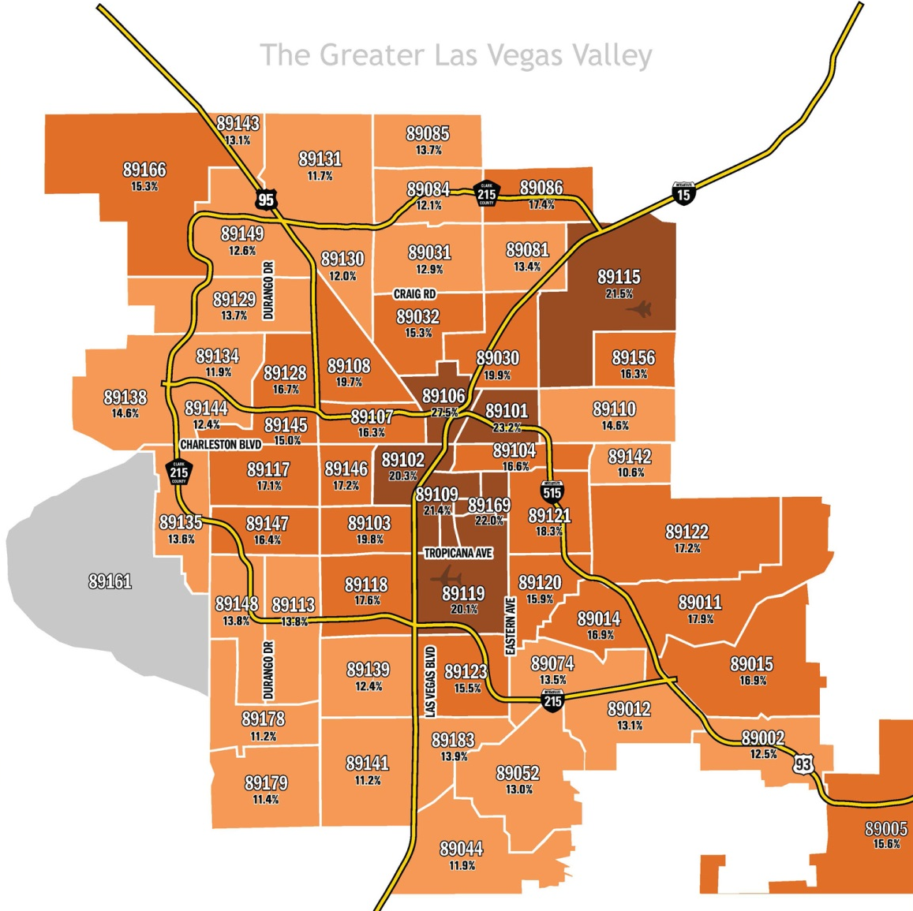
Plan for Health & Food Insecurity
Focus Area

Slide 21
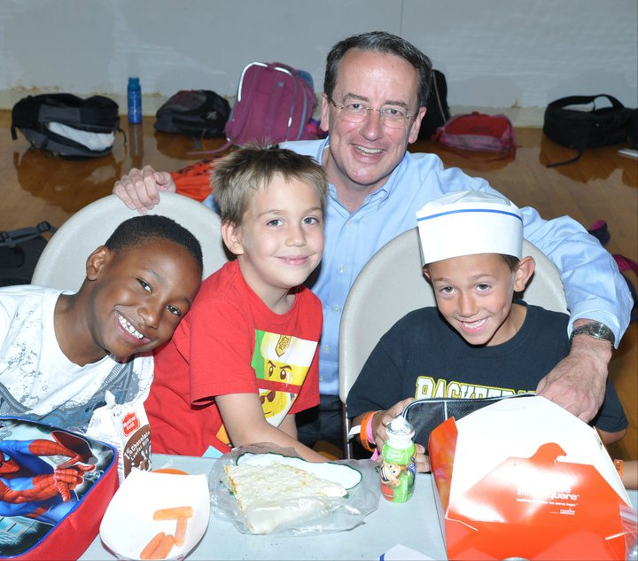
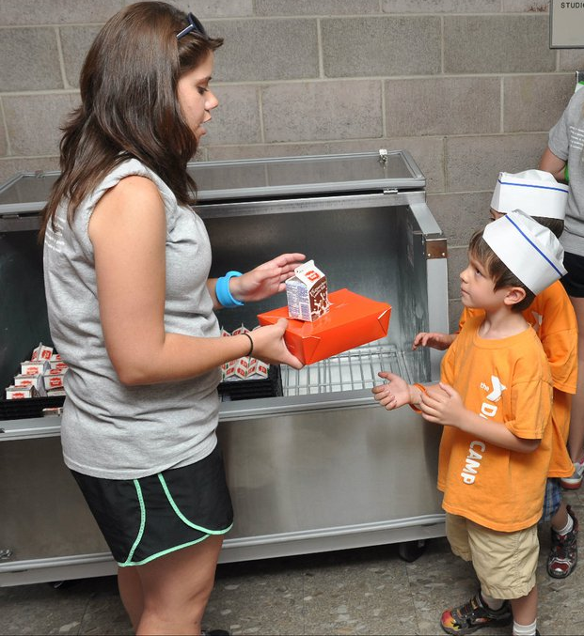
Food Pantry Services & Poverty Rates
Focus Area

Slide 22
Questions?
Jodi Tyson, MPH
Government Affairs Director Three Square Food Bank
JTyson@ThreeSquare.org
Thank you!

Slide 23
BUILD A CDFI RELATIONSHIP WITH YOUR INVEST HEALTH INITIATIVES
Brian Maddox , MPA
Chief Production Officer

Slide 24
WANT TO DATE A CDFI? HEALTHY INITIATIVE FINANCING TOPICS THAT MAKE US HOT
CDFI’s have the ability to provide creative financing for all sorts of needs, but what makes us hot:
Land Acquisition – With planned uses
Construction & Permanent Financing
Job Growth – Opportunities to create high paying jobs
Working Capital – As part of a larger debt facility
Small Business Loans

Slide 25
SPECIFIC TYPES OF PROJECTS THAT WILL GET YOU A SECOND DATE
Grocery Stores (Food Retailers)
Business Incubators (Co-ops)
Community Kitchens
FQHCs
Community Facilities
Distribution Centers
Quality Affordable Housing

Slide 26
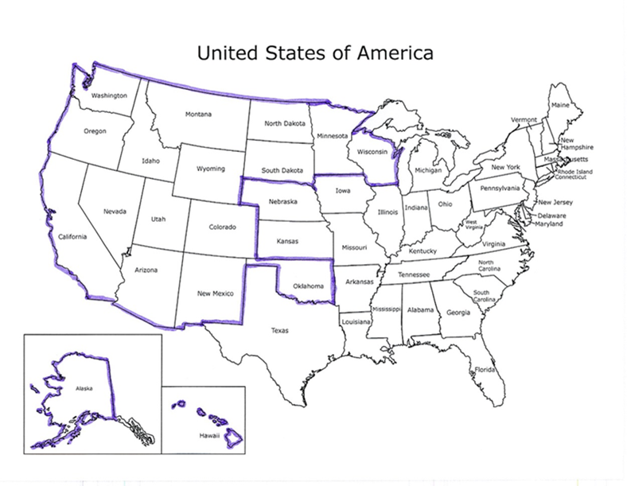
Who is Clearinghouse CDFI
Founded in 1996
Address Unmet Credit Needs
Community Development Lending is Sustainable
Unique For-Profit CDFI
Commercial Real Estate Secured
Footprint: - California, - Nevada, - Arizona, - New Mexico, and - Native Lands in Western USA

Slide 27
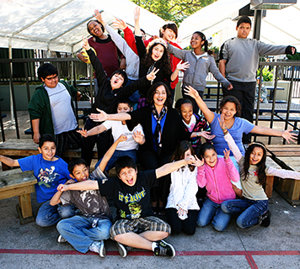
History of Impact
In Clearinghouse CDFI’s 21 Years of Lending We Have Changed Lives:
By Deploying over $1.35 Billion loans
Affordable Housing
$360 Million for Affordable Housing
Construction/Rehabilitation
Created/Preserved 7,200 Affordable Housing Units
1,110 Housing Units for No- To Low Income Earners in 2016
Community Development Projects
$320 Million for Development of
Community Facilities
1.5 Million Clients Served
Space and Funds for Over 16,000 Students
Free or Affordable Healthcare to 700 patients in 2016
Business/Job Creation
$ 341 Million to Support Small Business and Non-Profits
Created/Retained 16,500 Permanent and Construction Jobs
Growth and Revitalization
$331 Million of Lending for the Development or Rehabilitation of Community Projects
Developed or Preserved 15.9 Million Square Feet of Space
2 of 3 Loans Went to Woman or Minority Led/Owned Organizations in 2016

Slide 28
Brian Maddox , Chief Production Officer
Brianm@ccdfi.com
702-522-2283
Thank You!!!

Slide 29
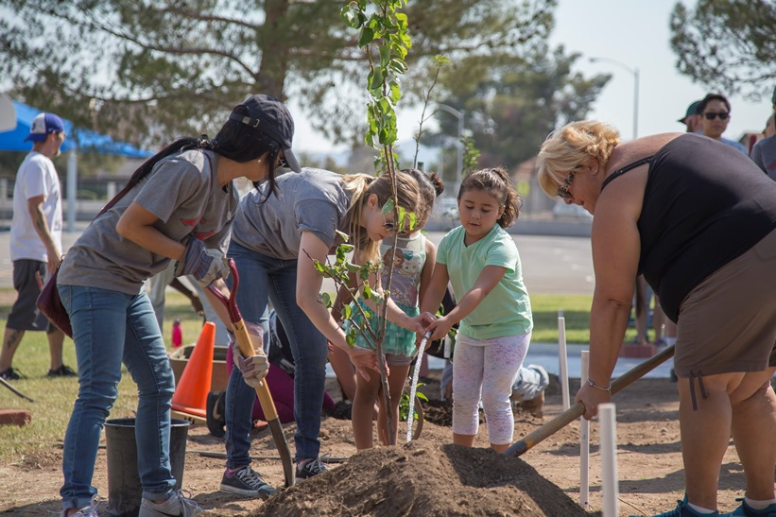
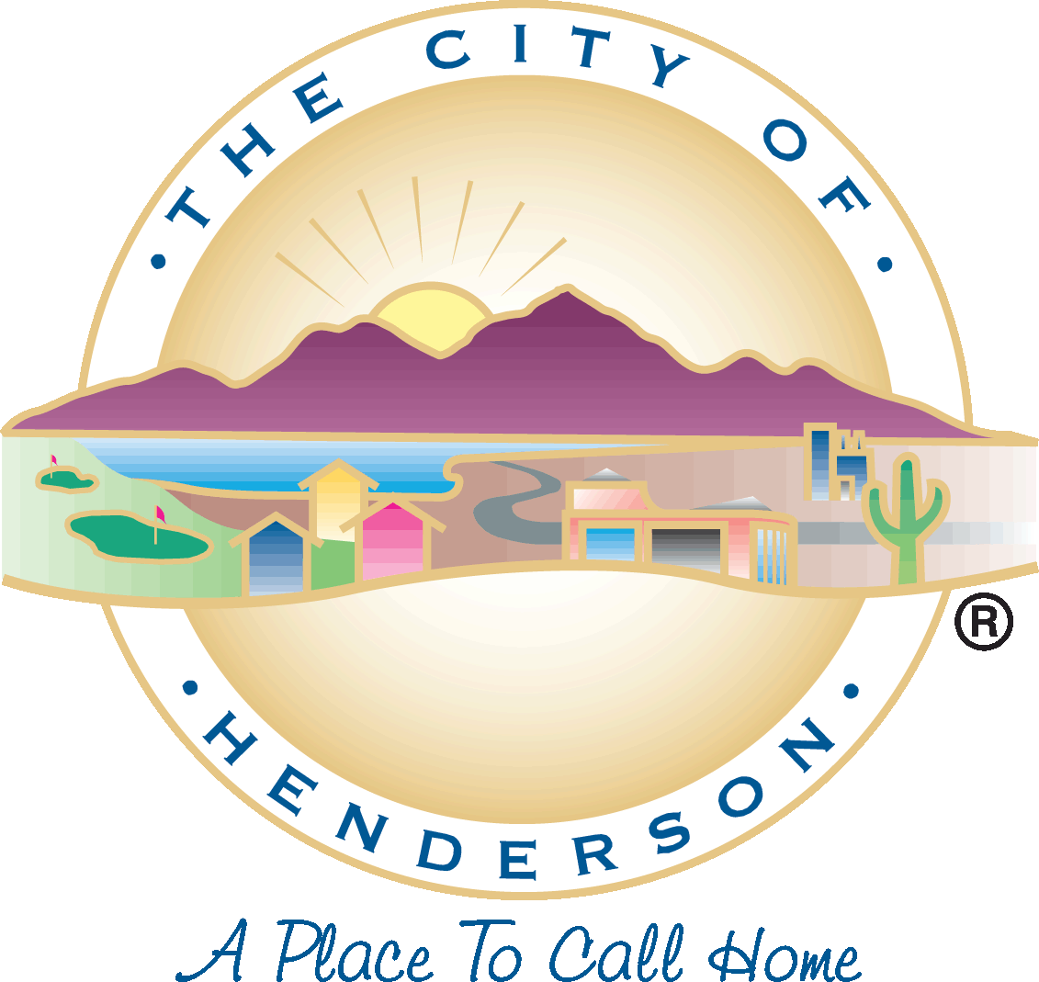
BRINGING “INVEST HEALTH” TO THE PITTMAN NEIGHBORHOOD
Stephanie Garcia-Vause, AICP Director of Community Development & Services Department City of Henderson

Slide 30
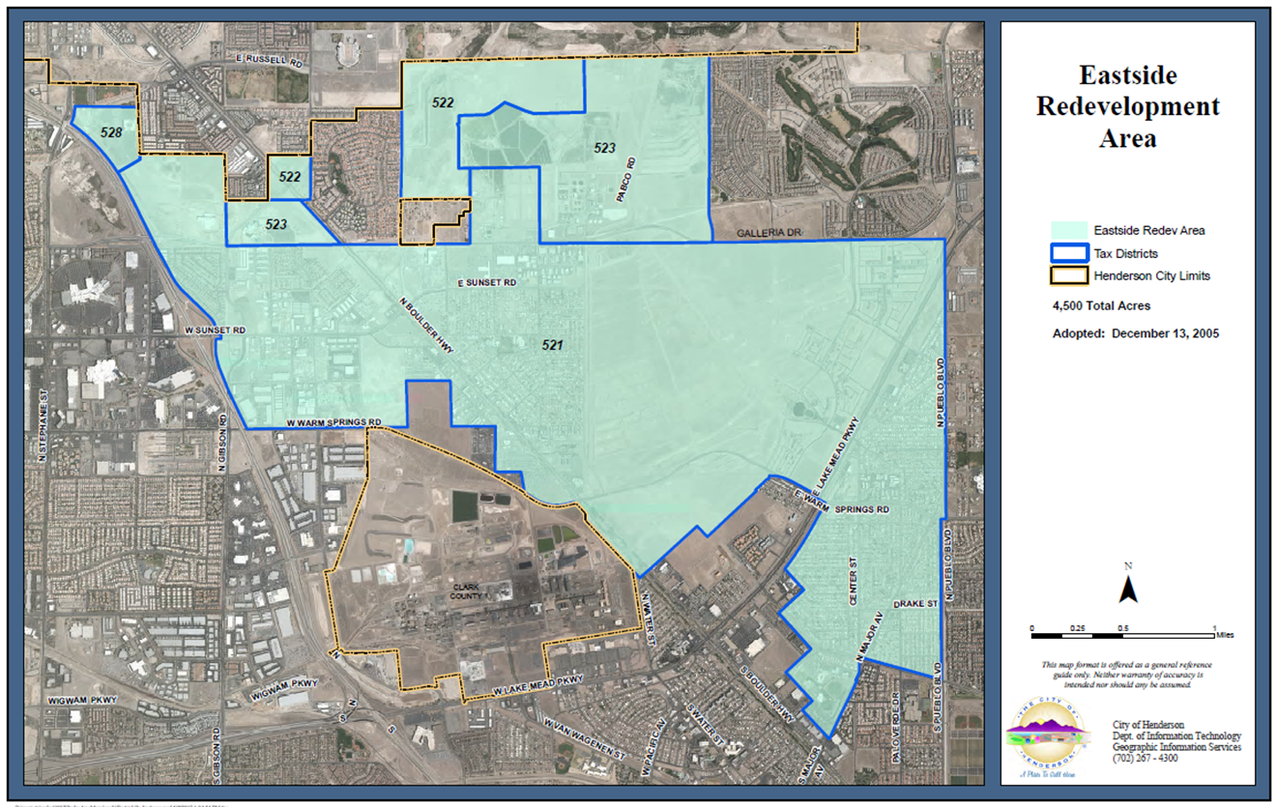
EASTSIDE HENDERSON REDEVELOPMENT AREA
PITTMAN
NEIGHBORHOOD

Slide 31
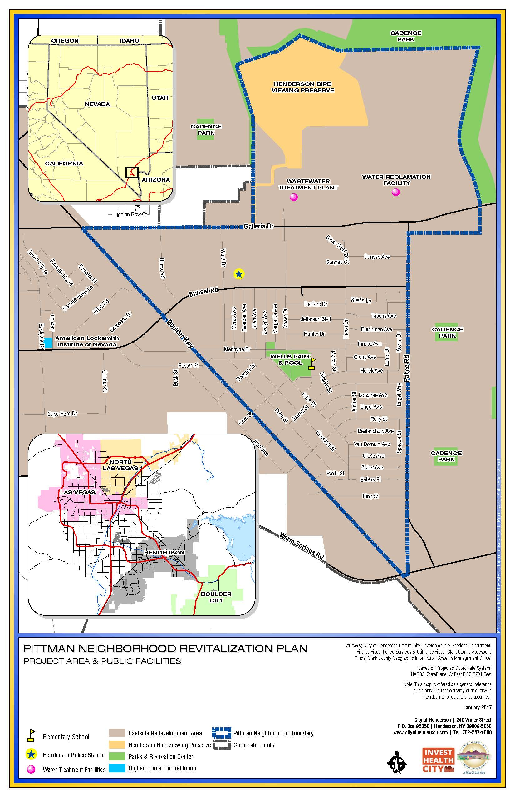
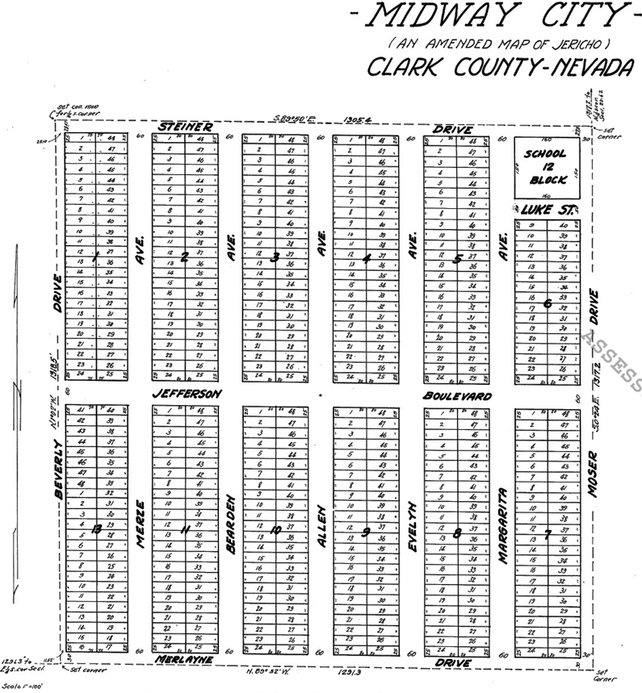
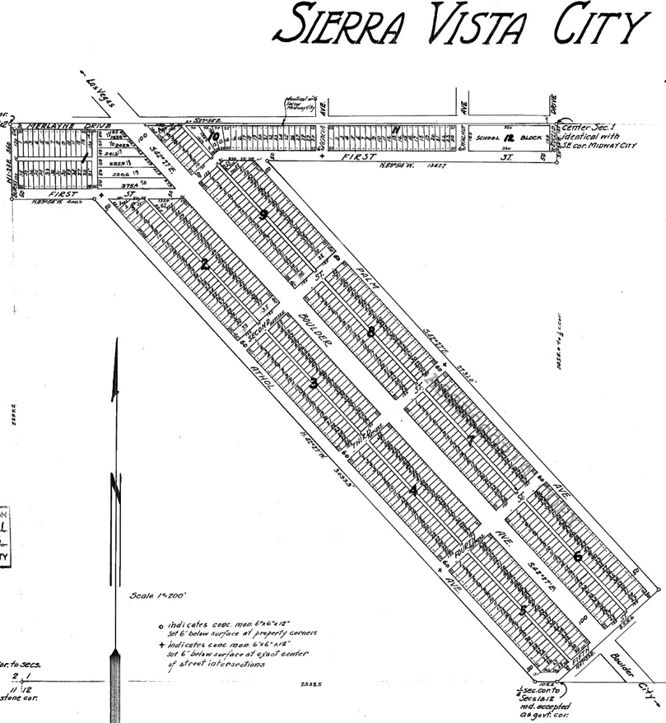
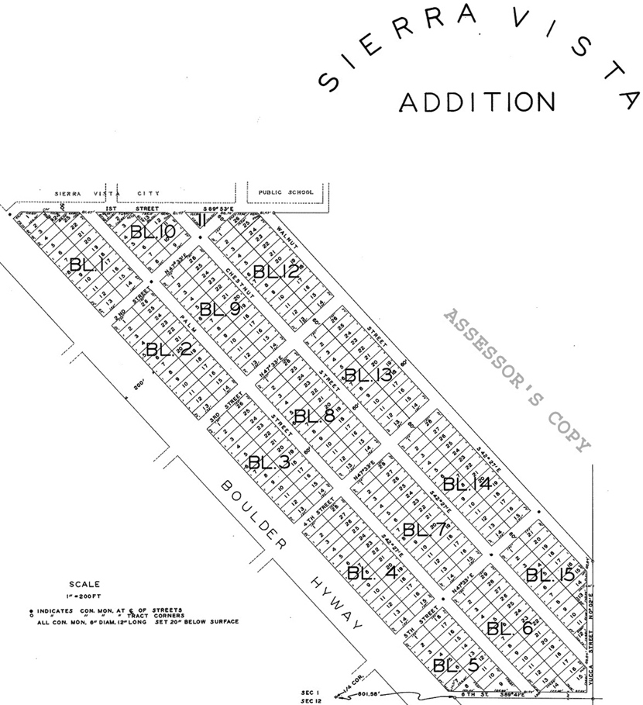
WHY PITTMAN? WHY NOW?
 | PITTMAN | HENDERSON
Population | 4,750 (1.3%) | 285,667
Hispanic | 1,235 (34%) | 14.9%
Homeownership | 52.3% | 62%
Median Household Income | $38,495 | $63,830
Persons in Poverty | ≥15% | 9.8%
Food Insecurity | 18% | 10%
Bachelor Degree or Higher | ≤15% | 30.7%
Home Median Value | ≤$150,000 | $213,700

Slide 32
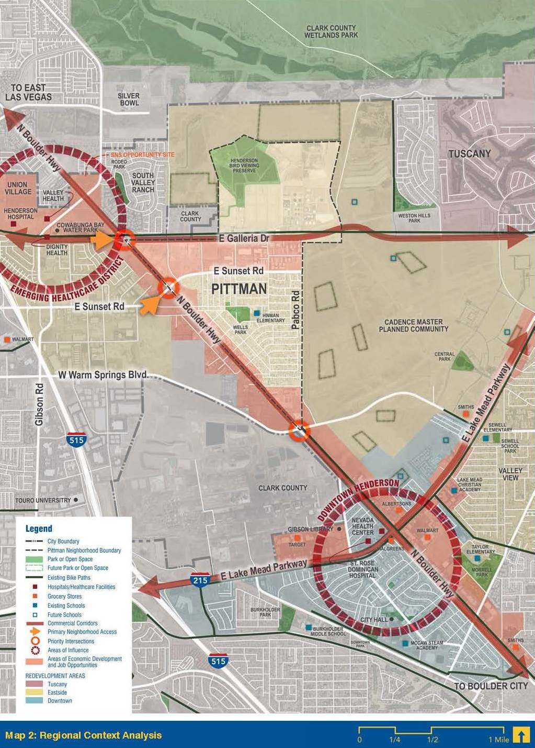
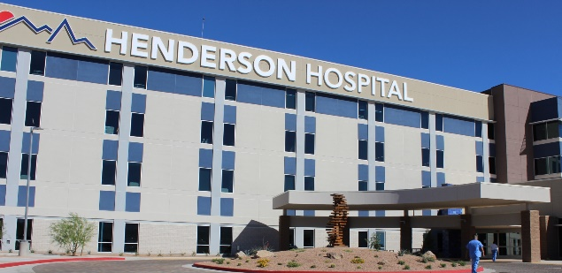
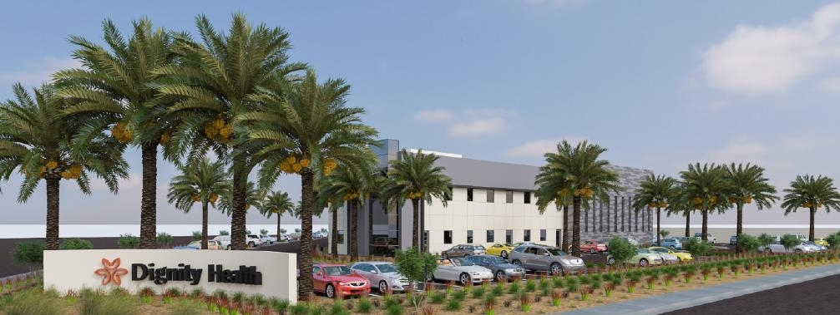
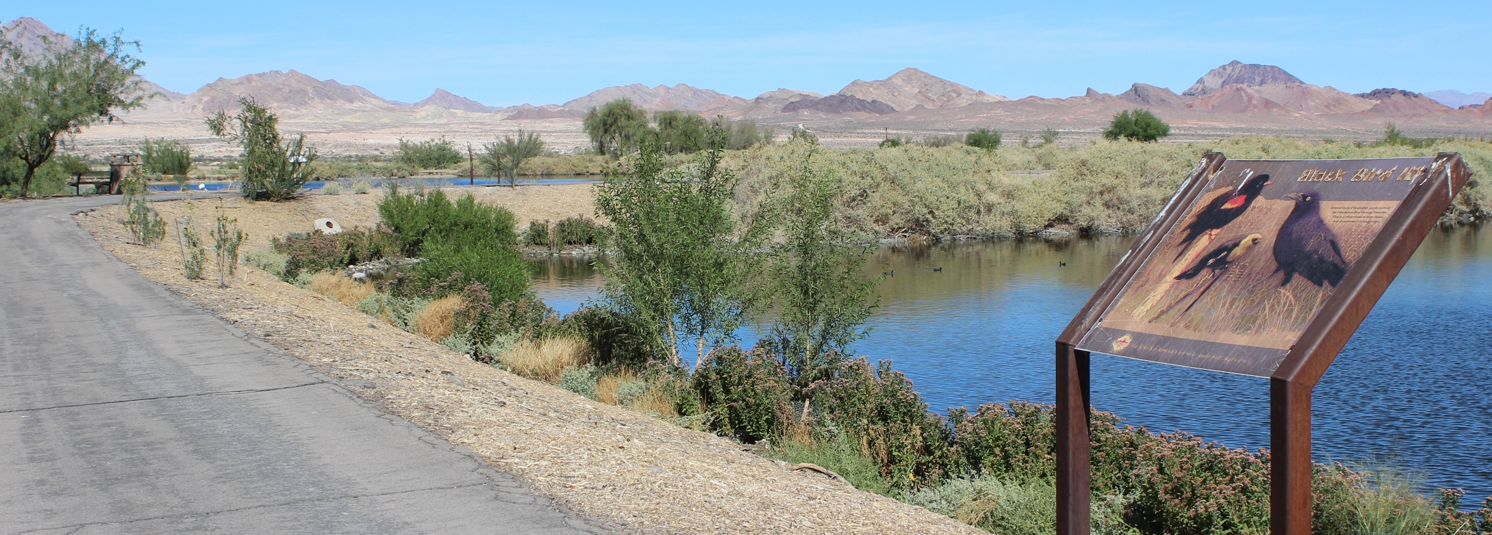
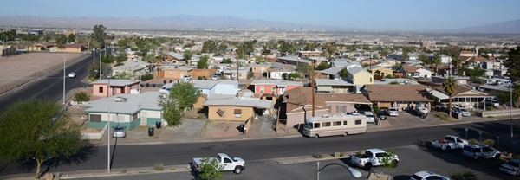
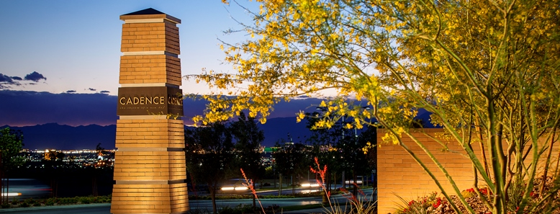
PITTMAN & SURROUNDINGS

Slide 33
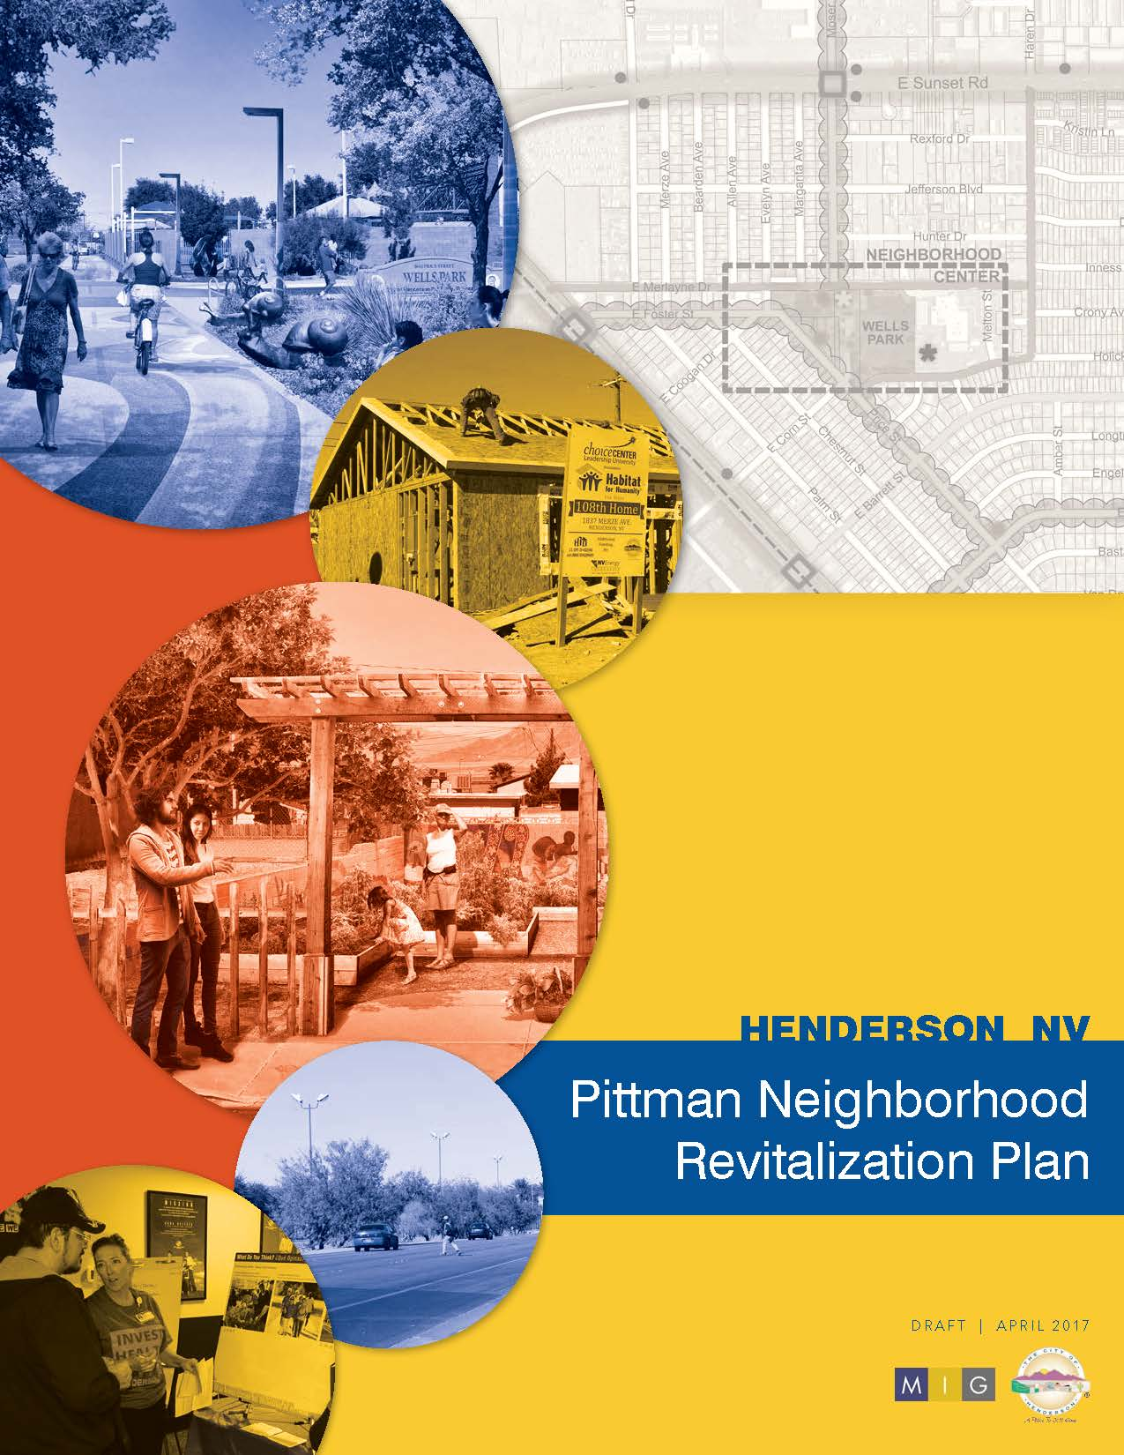
Pittman Neighborhood Revitalization Plan
INVEST HEALTH Strategies for Healthier Cities

Slide 34
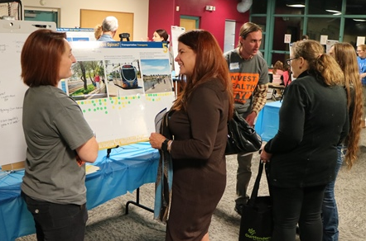
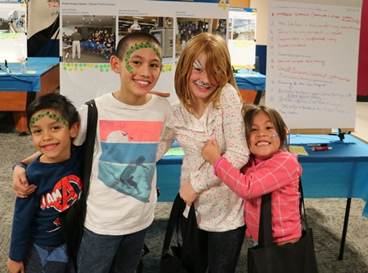
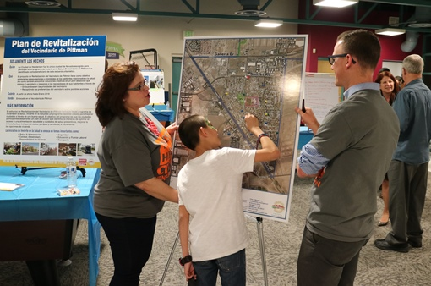
WHAT WE HEARD….
Food
Housing
Safety
Jobs
Pedestrian Amenities
PRIORITY #1
PRIORITY #2
PRIORITY #3
“It is not a fancy place but we like it”.
“Walking to the stores is difficult, they are too far away”.
“Having a weekend marketplace at the park with vendors bringing food for sale at affordable prices will be great…like the one at Green Valley, but not so expensive”.

Slide 35
NEIGHBORHOOD CORE ANALYSIS & PROJECTS

Slide 36
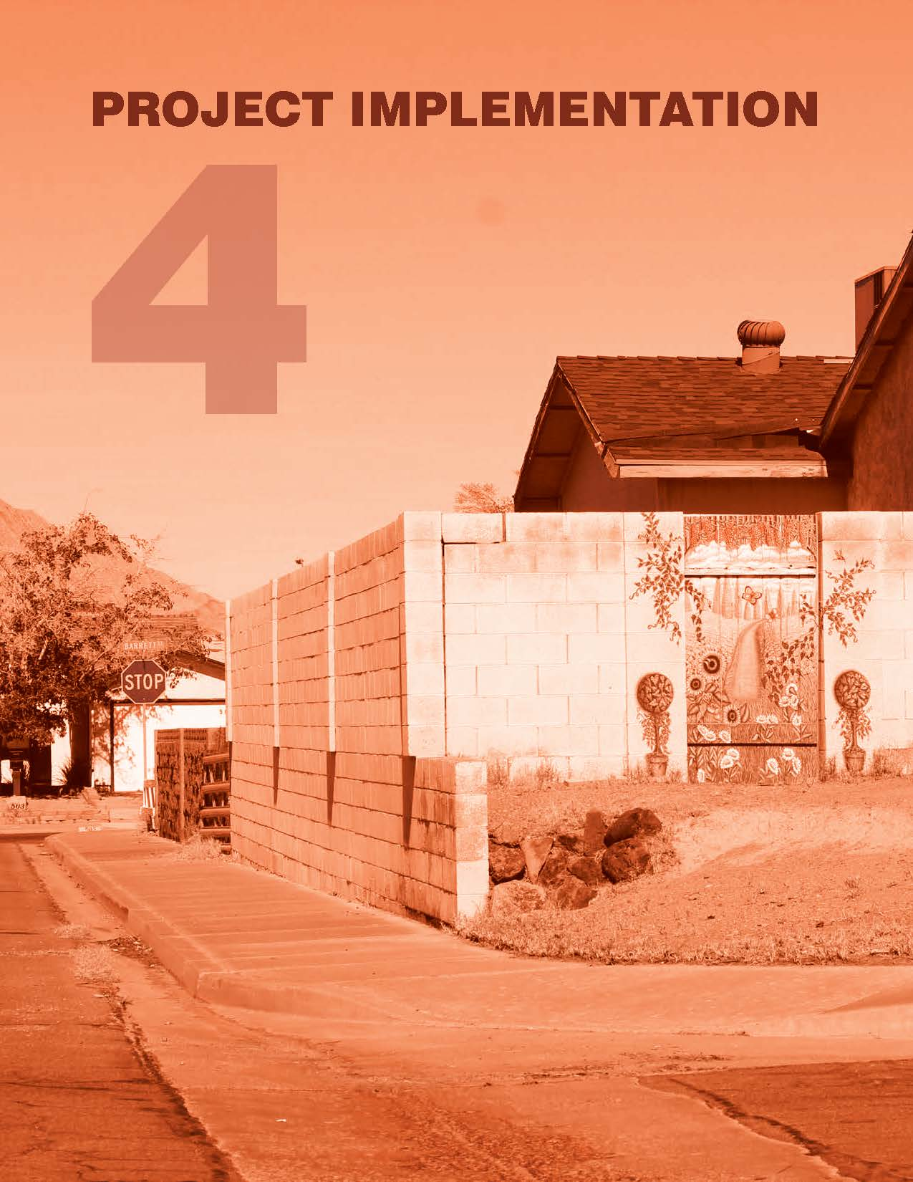
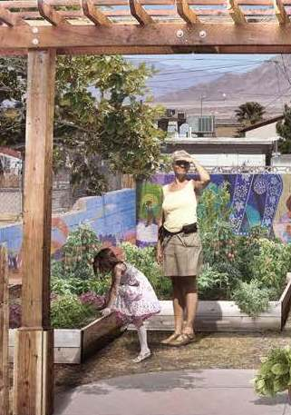
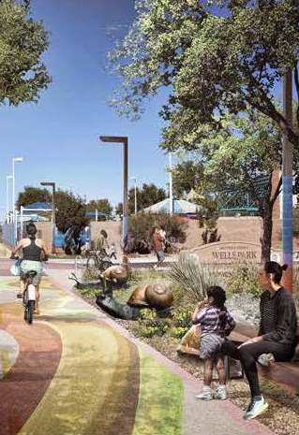

Slide 37
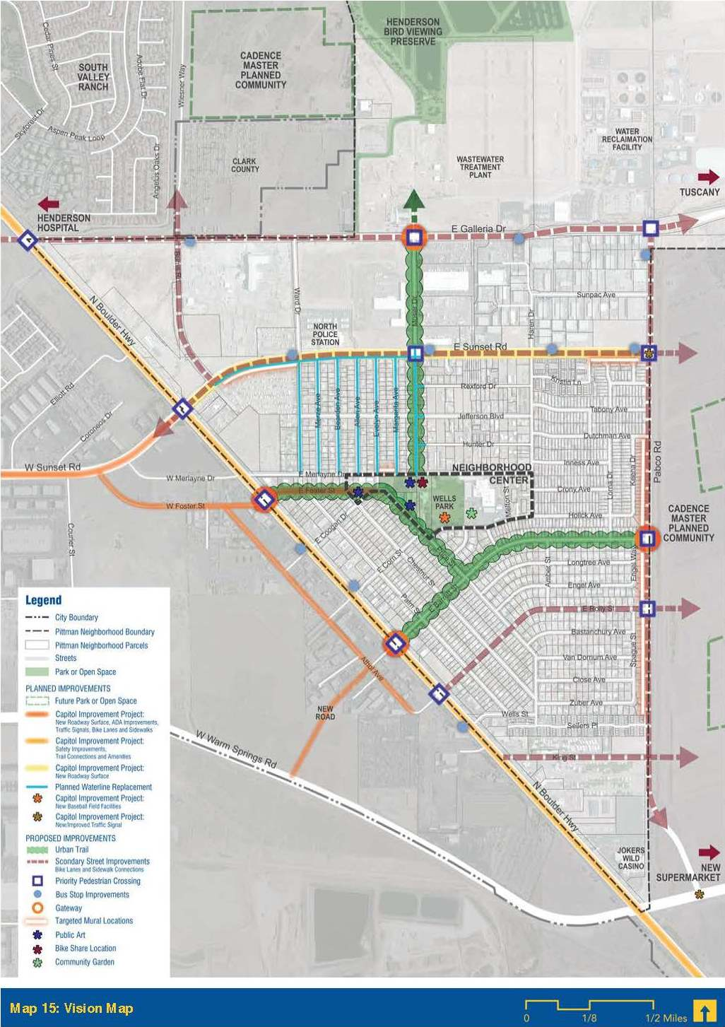
PLANNED & PROPOSED PROJECTS
Improvement of connectivity and pedestrian amenities throughout the neighborhood.-COH PW&PR + CD&S
Replacement of aged infrastructure, including waterlines.- COH Utilities + PW&PR
Incorporation of public art by painting a mural and engaging neighborhood organizations.- COH CD&S, RDA, B&GC + Edna Hinman

Slide 38
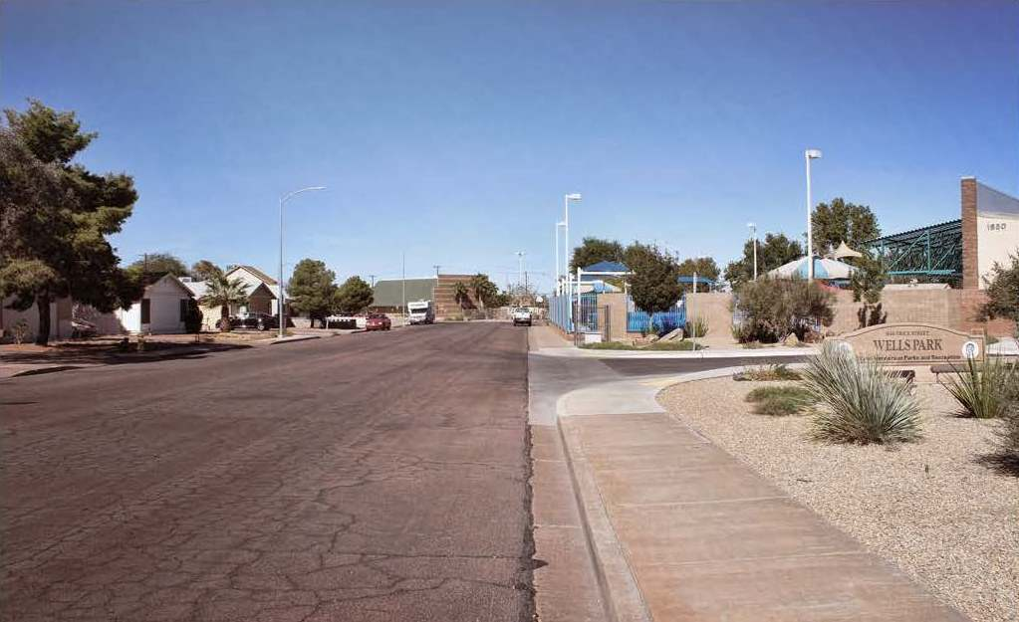
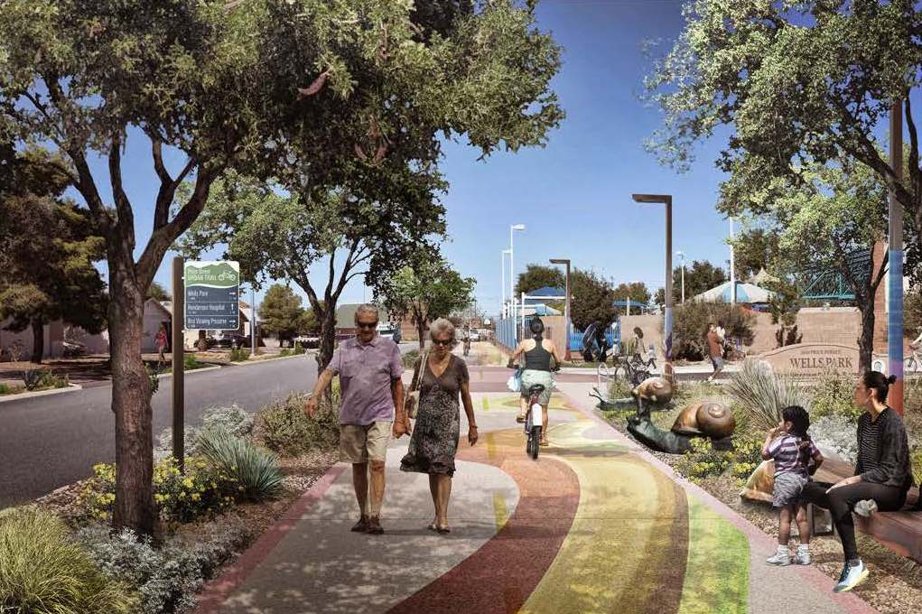
Opportunities for Enhanced Sidewalks

Slide 39
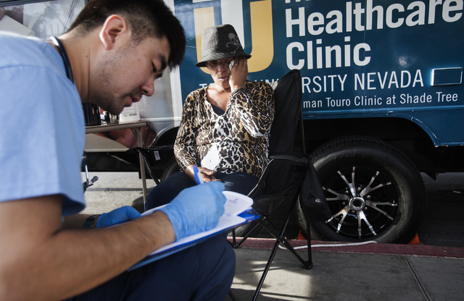
Touro University Nevada Mobile Healthcare Clinic

Slide 40
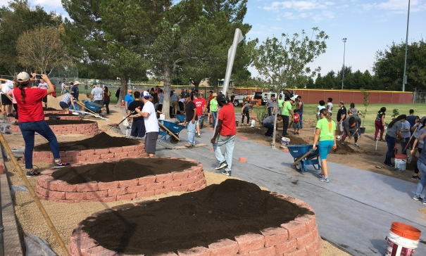
Hinman Elementary School
Edible Garden
Supper Club

Slide 41
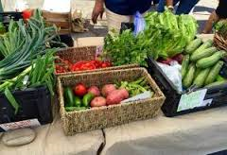
Veggie Buck Truck Mobile Farmer’s Market
MOBILE POP-UP FARMER’S MARKET

Slide 42
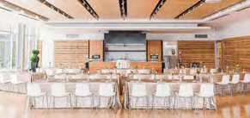
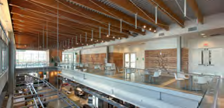
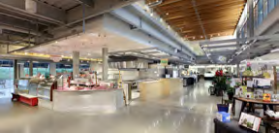
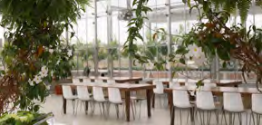
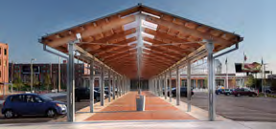
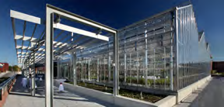
Opportunities for an innovative Mixed-use Market
PRIVATE
EVENTS
AREA
DEMO
KITCHEN
INDOOR
MARKET
AREA
MEETING
ROOMS
OUTDOOR
MARKET
AREA
CAFETERIA
TEACHING
KITCHEN
GREEN
HOUSE

Slide 43
THANK YOU!
QUESTIONS?
Stephanie Garcia-Vause, AICP Director of Community Development & Services City of Henderson Stephanie.Garcia-Vause@cityofhenderson.com

